Slide 1
PHP Database
ST2220 WEB APPLICATION DEVELOPMENT

Slide 2
Database
A database is an organized collection of data.
Database management systems (DBMSs) are specially designed applications that interact with the user, other applications, and the database itself to capture and analyze data.
In this module we will be using MySQL as our DBMS
A query is a question or a request.
We can query a database for specific information and have a recordset returned.

Slide 3

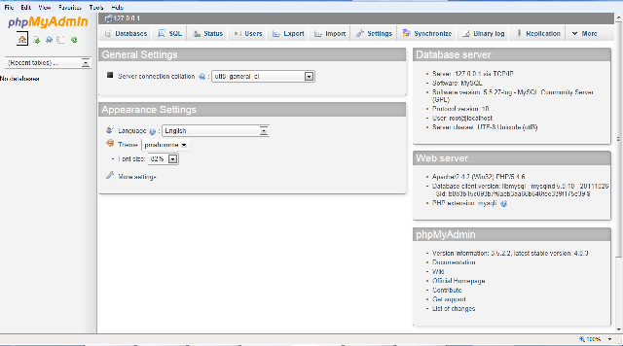
Creating Our First Database
We will be using the MySQL which came with EasyPHP.
Click on and select “Adminisration”.
Click on

Slide 4
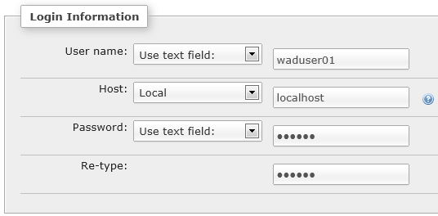
Creating a new User
Select select “Add user”.
Click “add user”.

Slide 5

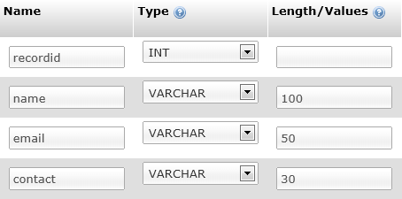

Creating a database
Select , name your database “MyContactBook” and click “create”.
Now you can create a table, click
name the table “friends”, click “save”.

Slide 6
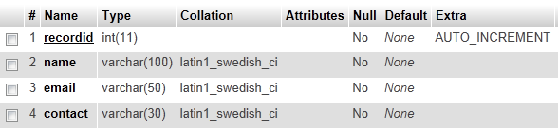

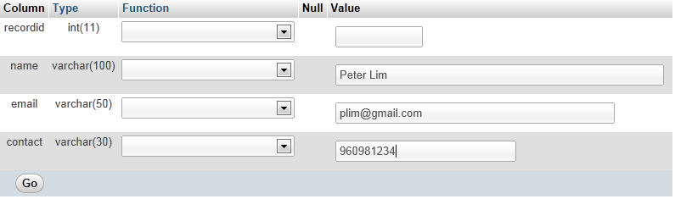
Add record to table
Click on
Click , key in the detail and click “Go”.

Slide 7
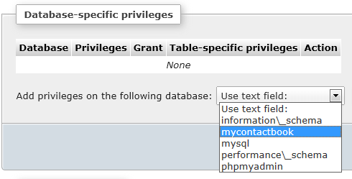
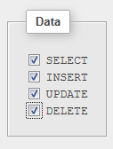
Granting User Privileges
Click on the select then select for “waduser01”.
Select “mycontactbook” under “Database-specific privileges” and click “go”. Check all the checkboxes under “Data” and click “go”.

Slide 8
Connecting to the database
we must open a connection to the MySQL server, before we can access data in a database.
The mysqli_connect() function, Syntax:
mysqli_connect(host, username, password, dbname);
Parameter | Description
host | Optional. Either a host name or an IP address
username | Optional. The MySQL user name
password | Optional. The password to log in with
dbname | Optional. The default database to be used when performing queries

Slide 9
Connecting to the database (example)
<?php
$con = mysqli_connect("localhost:3306", "waduser01", "st2220", "mycontactbook");
// Check connection
if (mysqli_connect_errno($con)) {
echo "Failed to connect to MySQL: " . mysqli_connect_error();
} else {
echo 'Success !';
mysqli_close($con);
}
?>
The connection will be closed automatically when the script ends. To close the connection before, use the mysqli_close() function.

Slide 10
Select record from the database
To learn more about SQL, please visit SQL tutorial.
Use the mysqli_query() function to get PHP to execute the statement below. This function is used to send a query or command to a MySQL connection
<?php
$con = mysqli_connect("localhost:3306", "waduser01", "st2220", "mycontactbook");
if (mysqli_connect_errno($con)) {
echo "Failed to connect to MySQL: " . mysqli_connect_error();
} else {
$result = mysqli_query($con,"SELECT * FROM friends");
while($row = mysqli_fetch_array($result)) {
echo "record ID: ". $row['recordid'] . "<br />";
echo "name: " . $row['name'] . "<br />";
echo "email: " . $row['email'] . "<br />";
echo "contact: " . $row['contact'] . "<br />";
echo "<br>";
}
mysqli_close($con);
}
?>

Slide 11
Select record from the database
The example stores the data returned by the mysqli_query() function in the $result variable.
Uses the mysqli_fetch_array() function to return the first row from the recordset as an array.
Each call to mysqli_fetch_array() returns the next row in the recordset.
The while loop loops through all the records in the recordset.
To print the value of each row, we use the PHP $row variable ($row['name'] and $row[‘contact']).

Slide 12
Insert record into the database
create an HTML form that can be used to add new records to the "friends" table.
<html>
<head>
<title>Insert example</title>
<meta http-equiv="Content-Type" content="text/html; charset=UTF-8">
</head>
<body>
<form action= "insertContact.php" method="post">
Name: <input type="text" name="name"><br />
email: <input type="text" name="email"><br />
contact: <input type="text" name="contact"><br />
<input type="submit">
</form>
</body>
</html>

Slide 13
Insert record into the database
Data is sent to "insertContact.php ".
The " insertContact.php " file connects to a database, and retrieves the values from the form with the PHP $_POST variables.
Then, the mysqli_query() function executes the INSERT INTO statement, and a new record will be added to the “friends" table.
<?php
$con = mysqli_connect("localhost:3306", "waduser01", "st2220", "mycontactbook");
if (mysqli_connect_errno($con)) {
echo "Failed to connect to MySQL: " . mysqli_connect_error();
} else {
$sql = "INSERT INTO friends (name, email, contact) ".
"VALUES ('$_POST[name]','$_POST[email]','$_POST[contact]')";
if (!mysqli_query($con, $sql)) {
die('Error: ' . mysqli_error($con));
}
echo "1 record added";
mysqli_close($con);
}
?>

Slide 14
The ORDER BY keyword
The ORDER BY keyword is used to sort the data in a recordset.
The ORDER BY keyword sort the records in ascending order by default.
If you want to sort the records in a descending order, you can use the DESC keyword.
<?php
$con = mysqli_connect("localhost:3306", "waduser01", "st2220", "mycontactbook");
if (mysqli_connect_errno($con)) {
echo "Failed to connect to MySQL: " . mysqli_connect_error();
} else {
$result = mysqli_query($con,"SELECT * FROM friends ORDER BY name");
while($row = mysqli_fetch_array($result)) {
echo "record ID: ". $row['recordid'] . "<br />";
echo "name: " . $row['name'] . "<br />";
echo "email: " . $row['email'] . "<br />";
echo "contact: " . $row['contact'] . "<br />";
echo "<br>";
}
mysqli_close($con);
}
?>

Slide 15
The WHERE clause
The WHERE clause is used to extract only those records that fulfill a specified criterion.
To learn more about SQL, please visit our SQL tutorial.
<?php
$con = mysqli_connect("localhost:3306", "waduser01", "st2220", "mycontactbook");
if (mysqli_connect_errno($con)) {
echo "Failed to connect to MySQL: " . mysqli_connect_error();
} else {
$result = mysqli_query($con,"SELECT * FROM friends WHERE name like 'Ma%'");
while($row = mysqli_fetch_array($result)) {
echo "record ID: ". $row['recordid'] . "<br />";
echo "name: " . $row['name'] . "<br />";
echo "email: " . $row['email'] . "<br />";
echo "contact: " . $row['contact'] . "<br />";
echo "<br>";
}
mysqli_close($con);
}
?>

Slide 16
Update record into the database
The UPDATE statement is used to update existing records in a table.
To learn more about SQL, please visit our SQL tutorial.
<?php
$con = mysqli_connect("localhost:3306", "waduser01", "st2220", "mycontactbook");
// Check connection
if (mysqli_connect_errno($con)) {
echo "Failed to connect to MySQL: " . mysqli_connect_error();
} else {
mysqli_query($con, "UPDATE friends SET contact='1111111' WHERE name='Mary'");
if (mysqli_affected_rows($con) > 0) {
echo "record updated.";
} else {
echo "NO record updated.";
}
mysqli_close($con);
}
?>

